Slide 1
Financial Accounting
IFRS 5th Edition
Weygandt ● Kimmel
Chapter 15
Financial Analysis: The Big Picture
This slide deck contains animations. Please disable animations if they cause issues with your device.
Copyright © John Wiley & Sons, Inc.

Slide 2
Chapter Outline
Learning Objectives
LO 1 Apply horizontal analysis and vertical analysis to financial statements.
LO 2 Analyze a company’s performance using ratio analysis.

Slide 3
Learning Objective 1 Apply Horizontal Analysis and Vertical Analysis to Financial Statements.
L O 1

Slide 4
Horizontal Analysis
Horizontal analysis, also called trend analysis, is a technique for evaluating a series of financial statement data over a period of time.
Its purpose is to determine the increase or decrease that has taken place.
The change can be expressed as either an amount or a percentage.
Commonly applied to the statement of financial position, income statement, and retained earnings statement.
L O 1

Slide 5


Horizontal Analysis on Net Sales
Illustration 15.1-4: Dubois SA’s net sales (1) Formula for horizontal analysis of changes since base period (2) Formula for horizontal analysis of current year in relation to base year (3) Horizontal analysis of Dubois SA’s net sales in relation to base period (4)
L O 1

Slide 6
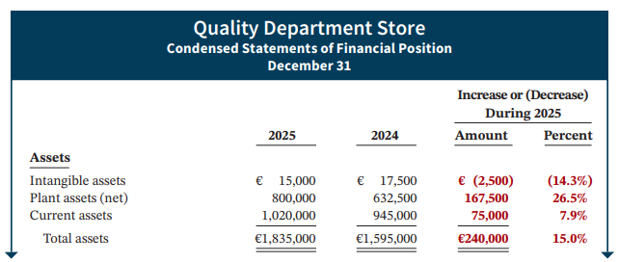
Statement of Financial Position (1 of 3)
Illustration 15.5: Horizontal analysis of statements of financial position
L O 1

Slide 7
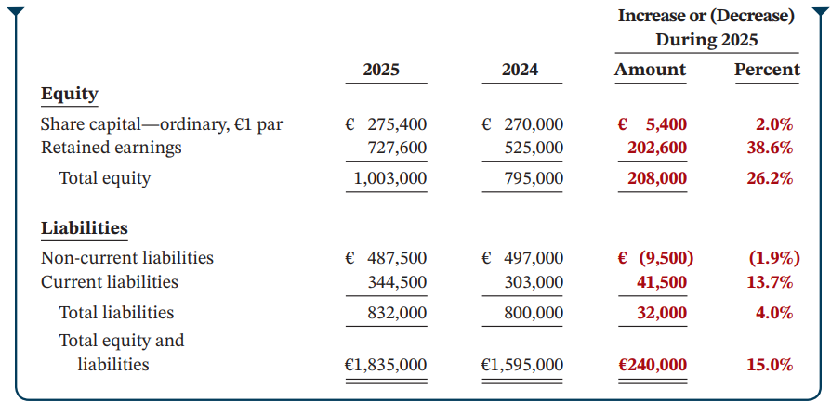
Statement of Financial Position (2 of 3)
Illustration 15.5: (continued)
L O 1
Notes:
Expanding assets, financing the expansion primiarily through RE rather than assuming long term debt

Slide 8
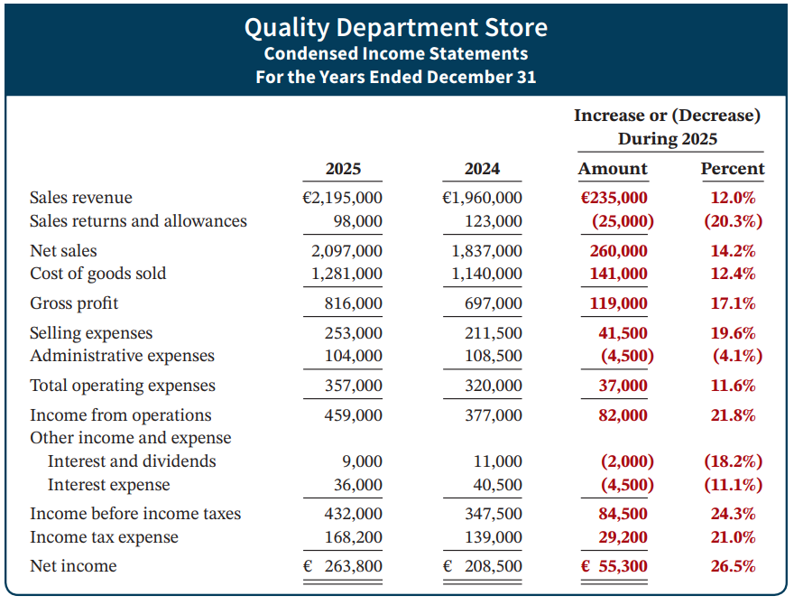
Income Statement
Overall, gross profit and net income were up substantially. Gross profit increased 17.1%, and net income, 26.5%. Quality’s profit trend appears favorable.
Illustration 15.6: Horizontal analysis of income statements
L O 1

Slide 9
Vertical Analysis
Vertical analysis, also called common-size analysis, is a technique that expresses each financial statement item as a percent of a base amount.
On a statement of financial position, we might say that current assets are 22% of total assets.
On an income statement, we might say that selling expenses are 16% of net sales.
Vertical analysis is commonly applied to the statement of financial position and the income statement.
L O 1

Slide 10
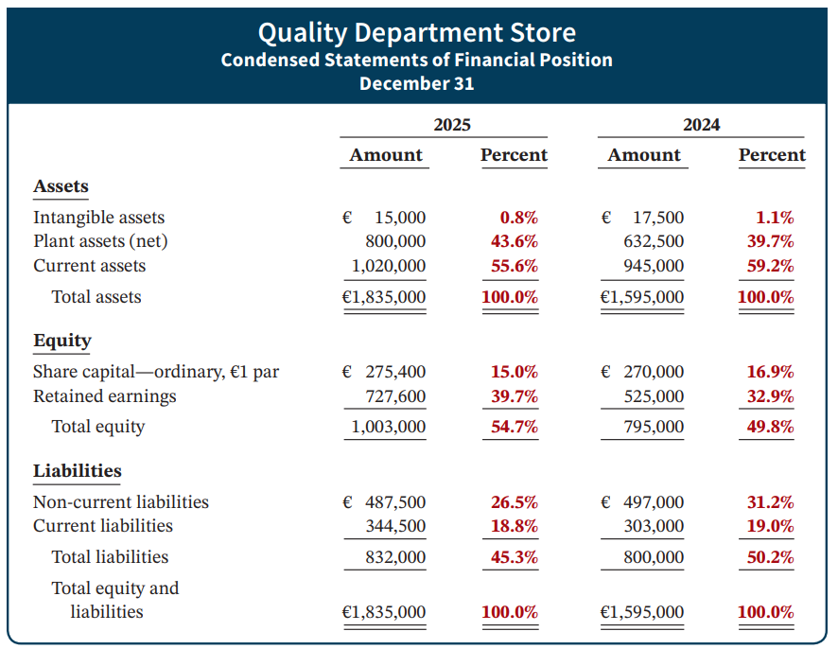
Vertical Analysis – Statement of Financial Position
Illustration 15.8: Vertical analysis of statements of financial position
L O 1

Slide 11
Learning Objective 2 Analyze a Company’s Performance Using Ratio Analysis.
L O 2

Slide 12
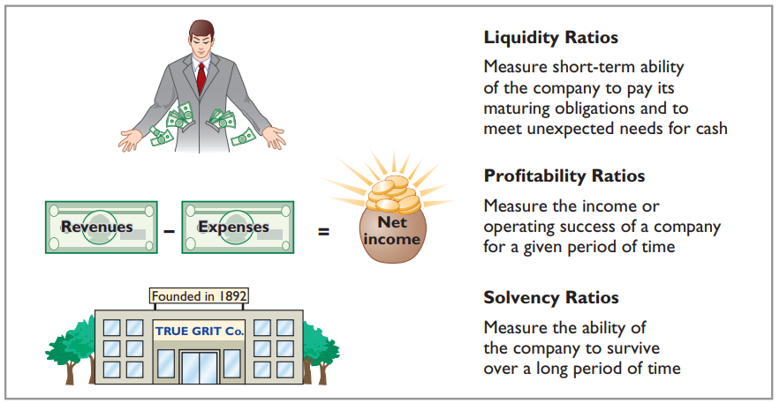
Ratio Analysis
Ratio analysis expresses the relationship among selected items of financial statement data.
Illustration 15.11: Financial ratio classifications
L O 2

Slide 13

Fundamental Analysis
Fundamental investing is an investment method that replies on analyzing a firm’s fundamentals. The goal is to attempt to tease out the intrinsic value of a stock rather than try to figure out if it's going to go up or down.
It is in contrast to some other investment strategies, such as quant investing or event driven investing.
It is used by long-term investors like Warren Buffett, or by many equity analysts.
Ratio analysis is a very important part of fundamental analysis.

Slide 14
Basics of Financial Statement Analysis
Imagine you are working as an investment analyst at a mutual fund.
Your client asks you: should I invest in Tesla?
How would you approach to this question?
L O 1

Slide 15
Things you need to think about
Firm fundamentals:
Liquidity: Does Tesla have enough asset to cover its short-term liabilities?
Profitability: is Tesla a profitable company?
Solvency: what is Tesla’s bankruptcy risk?
Valuation: is the company expensive?
Other things:
Macro trend (Monetary policy), industry competition, management, etc.

Slide 16
Liquidity Ratios
Measure the short-term ability of the company to pay its maturing obligations and to meet unexpected needs for cash.
Short-term creditors such as bankers and suppliers are particularly interested in assessing liquidity.
Ratios used include the current ratio, the acid-test ratio, accounts receivable turnover, and inventory turnover.
L O 2

Slide 17
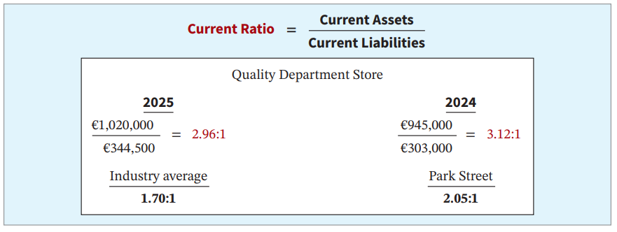
Current Ratio
Illustration 15.12: Current ratio
The 2025 ratio of 2.96:1 means that for every euro of current liabilities, Quality has €2.96 of current assets.
L O 2
Notes:
Company has become less liquid.
Compared to industry and competitor, they are more liquid.

Slide 18
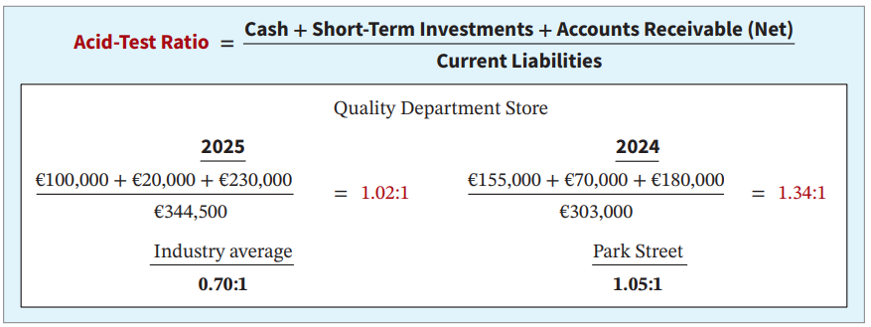
Acid-Test Ratio
Illustration 15.14: Acid-test ratio
The acid-test ratio measures immediate liquidity.
L O 2

Slide 19
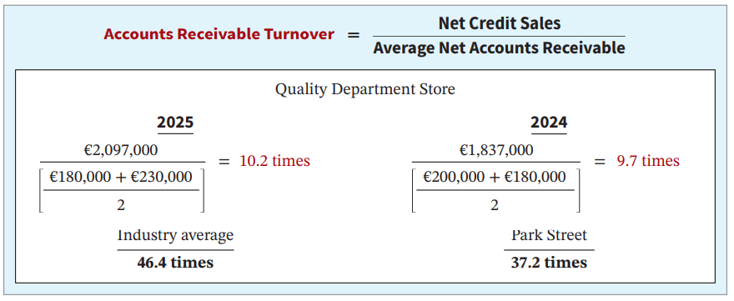
Accounts Receivable Turnover
Illustration 15.15: Vertical analysis of statements of financial position
The ratio measures the number of times, on average, the company collects receivables during the period.
L O 2
Notes:
Liquidity of a particular current asset, AR. How quickly can you convert AR into cash.
Net credit sales = Net sales minus net cash sales.
Net AR = AR minus allowance for doubtful accounts.

Slide 20
Accounts Collection Period
€2,097,000 |  | Accounts Receivable Turnover
(€180,000 + €230,000) ÷ 2 | = | 10.2 times
A variant of the Accounts Receivable Turnover ratio is to convert it to an average collection period in terms of days.
365 days ÷ 10.2 times = 35.78 days
The receivables are collected, on average, every 36 days, or about every 5 weeks.
L O 2

Slide 21
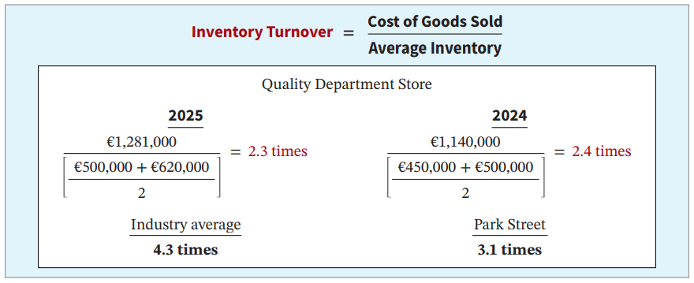
Inventory Turnover
Illustration 15.16: Inventory turnover
The ratio measures the number of times, on average, the inventory is sold during the period.
L O 2
Notes:
COGS --> How much we’ve sold over this period. Inventory liquidity determined by how quickly they can sell inventory.

Slide 22
Days in Inventory
€1,281,000 |  | Inventory Turnover
(€500,000 + €620,000) ÷ 2 | = | 2.3 times
A variant of the Inventory Turnover ratio is the days in inventory.
365 days ÷ 2.3 times = every 159 days
Quality’s average selling time for inventory is about 159 days.
Inventory turnover ratios vary considerably among industries.
L O 2
Notes:
Can also compute how long it takes to sell inventory.

Slide 23
Profitability Ratios
Measure the income or operating success of a company for a given period of time.
Income, or the lack of it, affects the company’s ability to obtain debt and equity financing; it also affects the company’s liquidity position, and the company’s ability to grow.
Analysts use the profit margin, asset turnover, return on assets, return on ordinary shareholders’ equity, earnings per share, price-earnings, and payout ratios.
L O 2

Slide 24
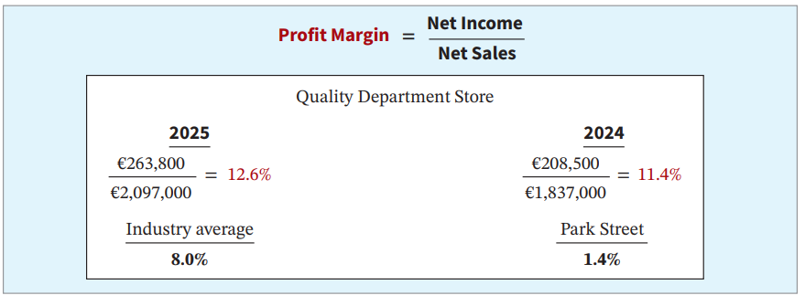
Profit Margin
Illustration 15.17: Profit margin
It measures the percentage of each euro of sales that results in net income.
L O 2
Notes:
Company has higher profit margin.

Slide 25
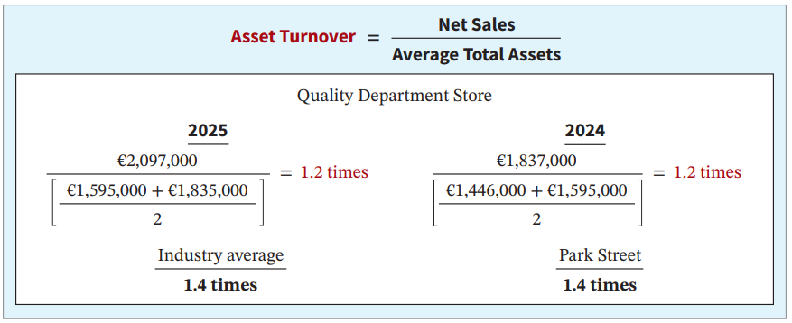
Asset Turnover
Illustration 15.18: Asset turnover
It measures how efficiently a company uses its assets to generate sales.
L O 2
Notes:
Company is less efficient compared to peers.

Slide 26
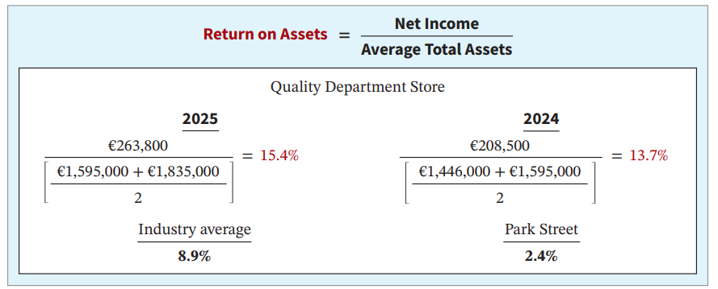
Return on Assets
Illustration 15.19: Return on assets
It is an overall measure of profitability.
L O 2
Notes:
Company ROA is higher.

Slide 27
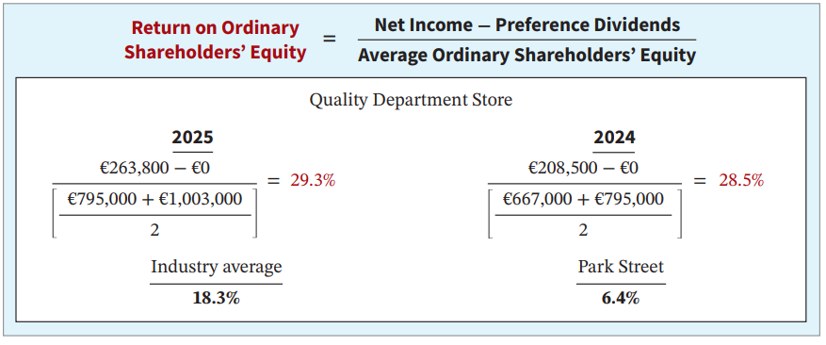
Return on Ordinary Shareholders’ Equity
Illustration 15.20: Return on ordinary shareholders’ equity
It shows how many euros of net income the company earned for each euro invested by the owners.
L O 2

Slide 28
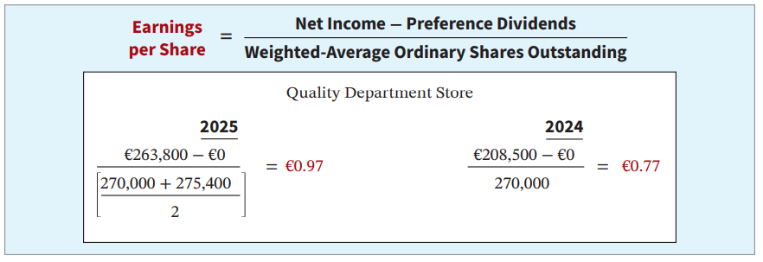
Earnings per Share (EPS)
Illustration 15.21: Earnings per share
A measure of the net income earned on each ordinary share.
L O 2

Slide 29


EPS is the number used by most analysts

Slide 30
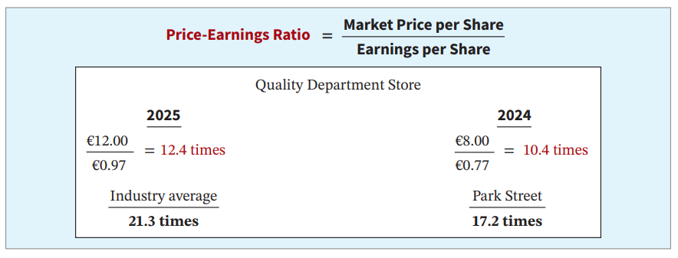
Price-Earnings Ratio
Illustration 15.22: Price-earnings ratio
It reflects investors’ assessments of a company’s future earnings.
L O 2

Slide 31
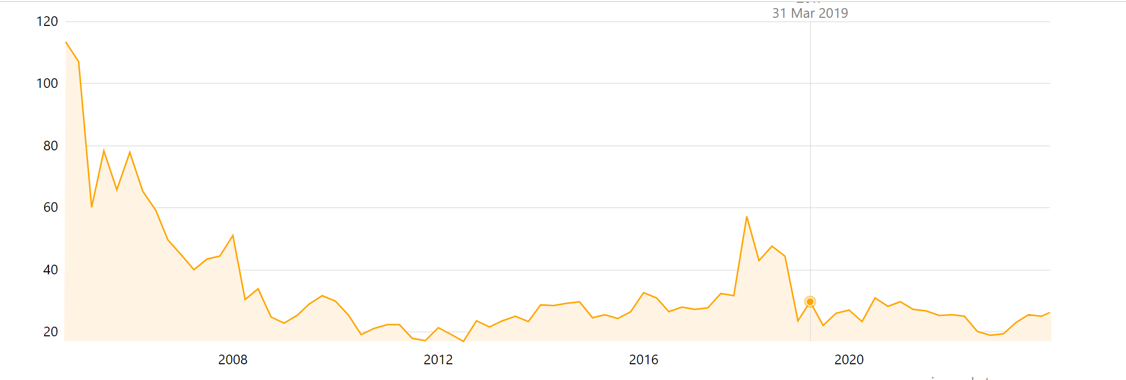
Google’s PE ratio
PE ratio is usually high for growth/young companies, because their earnings are low.
Investors are willing to assign a high PE ratio for those firms because they expect the earnings grow in the future.
As earnings grows, the PE ratio start to decrease.

Slide 32
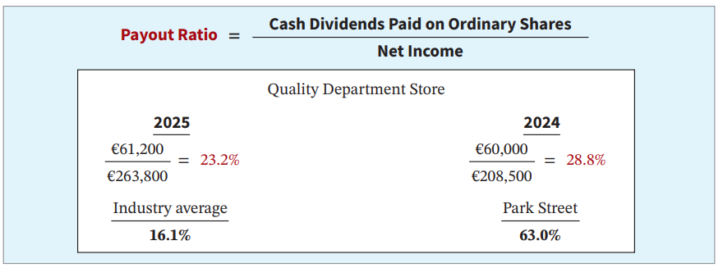
Payout Ratio
Illustration 15.23: Payout ratio
It measures the percentage of earnings distributed in the form of cash dividends.
L O 2

Slide 33
Solvency Ratios
Solvency ratios measure the ability of a company to survive over a long period of time.
Debt to Total Assets and
Times Interest Earned
are two ratios that provide information about a company’s debt-paying ability.
L O 2

Slide 34
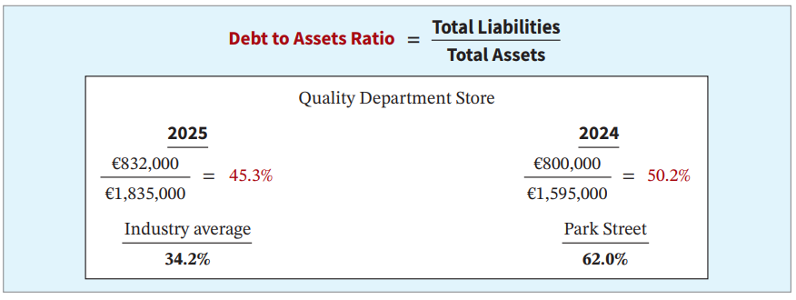
Debt to Assets Ratio
Illustration 15.24: Vertical analysis of statements of financial position
It measures the percentage of the total assets that creditors provide.
L O 2

Slide 35
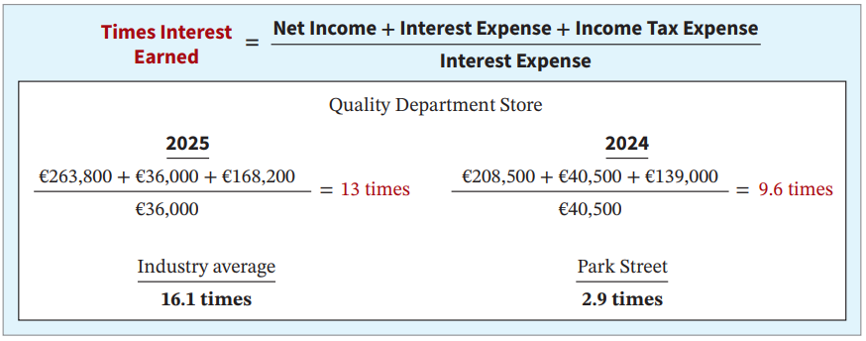
Times Interest Earned
Illustration 15.25: Times interest earned
It provides an indication of the company’s ability to meet interest payments as they come due.
L O 2

Slide 36
Summary of Ratios – Liquidity
Ratio | Formula | Purpose or Use
Liquidity Ratios
Current ratio |  | Measures short-term debt-paying ability.
Acid-test (quick) ratio |  | Measures immediate short-term liquidity.
Accounts receivable turnover |  | Measures liquidity of accounts receivable.
Inventory turnover |  | Measures liquidity of inventory.
Illustration 15.26 (partial): Summary of liquidity, profitability, and solvency ratios
L O 2

Slide 37
Summary of Ratios – Profitability
Profitability Ratios
Profit margin |  | Measures net income generated by each currency unit of sales.
Asset turnover |  | Measures how efficiently assets are used to generate sales.
Return on assets |  | Measures overall profitability of assets.
Return on ordinary shareholders’ equity |  | Measures profitability of owners’ investment.
Earnings per share (EPS) |  | Measures net income earned on each ordinary share.
Price-earnings (P-E) ratio |  | Measures the ratio of the market price per share to earnings per share.
Payout ratio |  | Measures percentage of earnings distributed in the form of cash dividends.
Illustration 15.26 (partial): Summary of liquidity, profitability, and solvency ratios
L O 2

Slide 38
Summary of Ratios – Solvency
Solvency Ratios
Debt to assets ratio |  | Measures the percentage of total assets provided by creditors.
Times interest earned |  | Measures ability to meet interest payments as they come due.
Illustration 15.26 (partial): Summary of liquidity, profitability, and solvency ratios
L O 2

Slide 39
Some additional thoughts
Ratio is the starting point in analyzing a business
The more important part is to understand the business:
How does the business make money
What is the business’ comparative advantage? (i.e., economic moat)

Slide 40
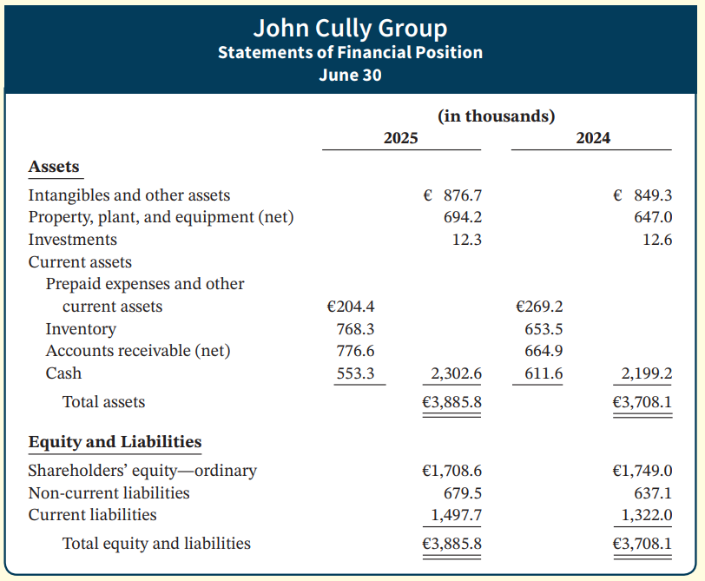
DO IT! 2: Ratio Analysis (1 of 3)
The condensed financial statements of John Cully Group, for the years ended June 30, 2025 and 2024 are presented below.
L O 2

Slide 41
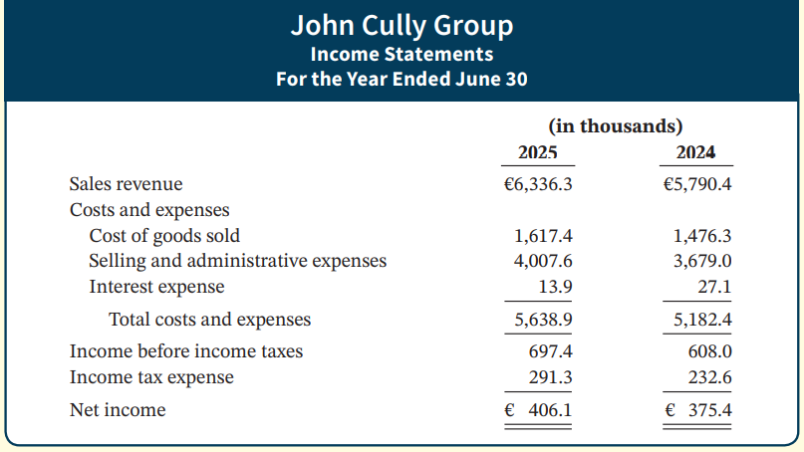
DO IT! 2: Ratio Analysis (2 of 3)
L O 2

Slide 42
DO IT! 2: Ratio Analysis (3 of 3)
Compute the following ratios for 2025 and 2024.
Current ratio
Inventory turnover. (Inventory on 6/30/23 was €599.0).
Profit margin.
Return on assets. (Assets on 6/30/23 were €3,349.9.)
Return on ordinary shareholders’ equity. (Equity on 6/30/23 was €1,795.9.)
Debt to assets ratio.
Times interest earned.
L O 2

Slide 43
DO IT! 2: Ratio Analysis – Solution (a) – (d)
 | 2025 | 2024
Current ratio:
€2,302.6 ÷ €1,497.7 = | 1.5:1
€2,199.2 ÷ €1,322.0 = |  | 1.7:1
Inventory turnover:
€1,617.4 ÷ [(€768.3 + €653.5) ÷ 2] = | 2.3 times
€1,476.3 ÷ [(€653.5 + €599.0) ÷ 2] = |  | 2.4 times
Profit margin:
€406.1 ÷ €6,336.3 = | 6.4%
€375.4 ÷ €5,790.4 = |  | 6.5%
Return on assets:
€406.1 ÷ [(€3,885.8 + €3,708.1) ÷ 2] = | 10.7%
€375.4 ÷ [(€3,708.1 + €3,349.9) ÷ 2] = |  | 10.6%
L O 2

Slide 44
DO IT! 2: Ratio Analysis – Solution (e) – (g)
 | 2025 | 2024
Return on ordinary shareholders’ equity:
(€406.1 − €0) ÷ [(€1,708.6 + €1,749.0) ÷ 2] = | 23.5%
(€375.4 − €0) ÷ [(€1,749.0 + €1,795.9) ÷ 2] = |  | 21.2%
Debt to assets ratio:
(€1,497.7 + €679.5) ÷ €3,885.8 = | 56.0%
(€1,322.0 + €637.1) ÷ €3,708.1 = |  | 52.8%
Times interest earned:
(€406.1 + €291.3 + €13.9) ÷ €13.9 = | 51.2 times
(€375.4 + €232.6 + €27.1) ÷ €27.1 = |  | 23.4 times
L O 2

